Slide 1

Contents
Rectifiers
Half wave rectifiers
Full wave rectifiers
Bridge rectifier
Ripple factor
PIV
Rectification Efficiency
Capacitive and Inductive filters
RC Coupled Amplifier
Oscillators
RC Oscillators
LC Oscillators

Slide 2
Rectifiers
The process of converting the AC current into DC current is called rectification.
Rectification can be achieved by using a single diode or group of diodes.
The circuit which converts the AC current into DC current are called rectifiers.
Types of rectifiers
Rectifiers are generally classified into two types:
Half wave rectifier
Full wave rectifier (with 2 doides)/Bridge rectifier(with 4 diodes)

Slide 3
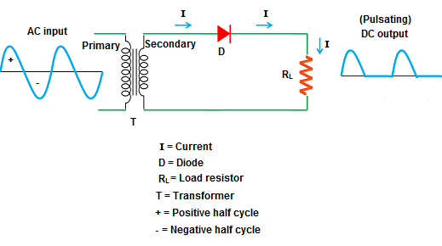
HALF WAVE RECTIFIER
A half wave rectifier is defined as a rectifier that only allows one half-cycle of an AC voltage waveform to pass, blocking the other half-cycle.
Half-wave rectifiers are used to convert AC voltage to pulsating DC voltage during one half cycle
It requires a single diode to construct.
Circuit diagram

Slide 4

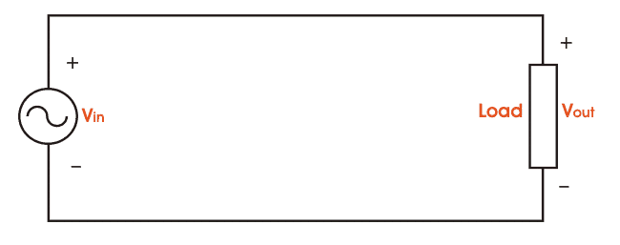
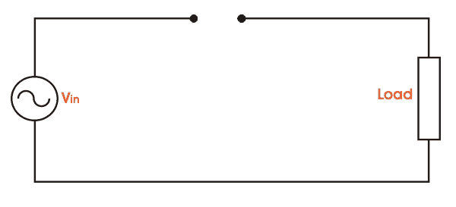
OPERATION OF HALF WAVE RECTIFIER
First, a high AC voltage is applied to the primary side of the step-down transformer and a low voltage at the secondary winding is obtained which will be applied to the diode.
During the positive half cycle of the AC voltage, the diode will be forward biased and the current flows through the diode.
During the negative half cycle of the AC voltage, the diode will be reverse biased and the flow of current will be blocked.

Slide 5
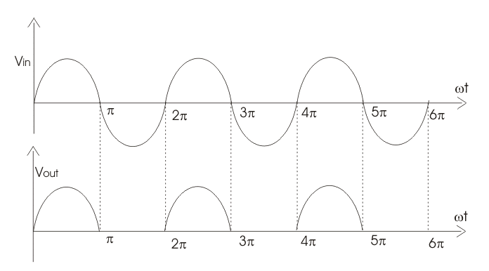
The final output voltage waveform on the secondary side (DC) of Half Wave Rectifier

Slide 6
Ripple Factor of Half Wave Rectifier
Ripple is the unwanted AC component remaining when converting the AC voltage waveform into a DC waveform. Even though rectifiers try to remove all AC components, there is still some small amount left on the output side which pulsates the DC waveform. This undesirable AC component is called ripple.
To quantify how well the half-wave rectifier can convert the AC voltage into DC voltage, we use what is known as the Ripple Factor (represented by γ or r).
The ripple factor is the ratio between the RMS value of the AC voltage (on the input side) and the DC voltage (on the output side) of the rectifier.

Slide 7



Ripple Factor of Half Wave Rectifier
The formula for ripple factor is:$γ=\sqrt{{\left(\frac{I_{rms}^{}}{I_{dc}}\right)}^{2}−1}$
RMS value of Half Wave Rectifier
To derive the RMS value of half wave rectifier, we need to calculate the current across the load. If the instantaneous load current is equal to i_{L} = I_{m}sinωt,
Then the average of load current (I_{DC}) is :
where I_{m} is equal to the peak instantaneous current across the load (I_{max}). Hence the output DC current (I_{DC}) obtained across the load is:

Slide 8


For a half-wave rectifier, the RMS load current (I_{rms}) is equal to the average current (I_{DC}) multiple by π/2.
Hence the RMS value of the load current (I_{rms}) for a half wave rectifier is:
Where I_{m}= I_{max} which is equal to the peak instantaneous current across the load.
Substituting in the formula of ripple factor,
the ripple factor of a half-wave rectifier is 1.21.
Peak Inverse Voltage(PIV) of Half Wave Rectifier
Peak Inverse Voltage (PIV) is the maximum voltage that the diode can withstand during reverse bias condition. If a voltage is applied more than the PIV, the diode will be destroyed.
For Half Wave Rectifier PIV is $V_{m}$

Slide 9

Efficiency of Half Wave Rectifier
The ratio of input AC to output DC is known as efficiency.
A DC power that is delivered to the load is
Pdc = I²_{dc} R_{L} = (I_{MAX}/ᴨ)² R_{L}
The input AC power to the transformer,
Pac=Power dissipation in load resistance + power dissipation in the junction diode
Pac= I²_{rms}R_{F} + I²_{rms}R_{L} = {I²_{MAX}/4} [R_{F} + R_{L}]
Efficiency= Pdc/Pac = 0.406/{1+R_{F}/R_{L}}
The efficiency of a half wave rectifier is 40.6% when R_{F} is neglected.

Slide 10
Applications of Half Wave Rectifier
For rectification applications
For signal demodulation applications
For signal peak applications
Advantages of Half Wave Rectifier
Simple (lower number of components)
Cheaper up front cost (as their is less equipment.
Disadvantages of Half Wave Rectifier
They only allow a half-cycle through per sinewave, and the other half-cycle is wasted. This leads to power loss.
They produces a low output voltage.
The output current we obtain is not purely DC, and it still contains a lot of ripple (i.e. it has a high ripple factor)

Slide 11
FULL WAVE RECTIFIER
A Full Wave Rectifier is a circuit, which converts an ac voltage into a pulsating dc voltage using both half cycles of the applied ac voltage.
This process of converting both half cycles of the input supply (alternating current) to direct current (DC) is termed full wave rectification.
It uses two diodes of which one conducts during one half cycle while the other conducts during the other half cycle of the applied ac voltage.
Full wave rectifier can be constructed in 2 ways.
The first method makes use of a centre tapped transformer and 2 diodes. This arrangement is known as Center Tapped Full Wave Rectifier.
The second method uses a normal transformer with 4 diodes arranged as a bridge. This arrangement is known as a Bridge Rectifier.

Slide 12
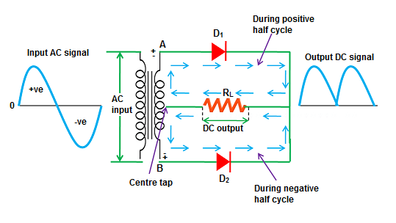
Circuit Diagram of Full wave Rectifier
The rectifier circuit consists of
centre tapped step-down transformer
two diodes and they are.
Thus, this type of rectifier where centre tapping is provided is called centre tap rectifier.
The load resistor is connected, and the output voltage is obtained across this resistor.

Slide 13
CENTER TAPPED TRANSFORMER
When an additional wire is connected across the exact middle of the secondary winding of a transformer, it is known as a center tapped transformer
The wire is adjusted in such a way that it falls in the exact middle point of the secondary winding. So the wire is exactly at zero volts of the AC signal.
The upper part of the secondary winding produces a positive voltage V₁ and the lower part of the secondary winding produces a negative voltage V₂. When we combine these two voltages at output load, we get a complete AC signal.
i.e. V_{Total} = V₁ + V₂

Slide 14
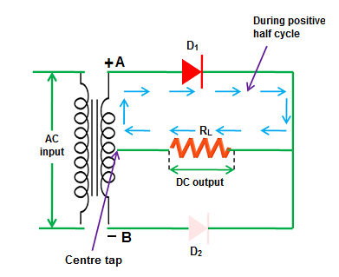
Operation: When input AC voltage is applied, the secondary winding of the center tapped transformer divides this input AC voltage into two parts: positive and negative.
During the positive half cycle of the input AC signal
Terminal A become positive and terminal B become negative and center tap is grounded (zero volts).
So the diode D₁ is forward biased during the positive half cycle and allows electric current through it.

Slide 15
On the other hand, the negative terminal B is connected to the p-side of the diode D₂ .
So the diode D₂ is reverse biased during the positive half cycle and does not allow electric current through it.
The diode D₁ supplies DC current to the load R_{L}.
The DC current produced at the load R_{L} will return to the secondary winding through a center tap.
During the positive half cycle, current flows only in the upper part of the circuit while the lower part of the circuit carry no current to the load because the diode D₂ is reverse biased.
Thus, during the positive half cycle of the input AC signal, only diode D₁ allows electric current while diode D₂ does not allow electric current.

Slide 16
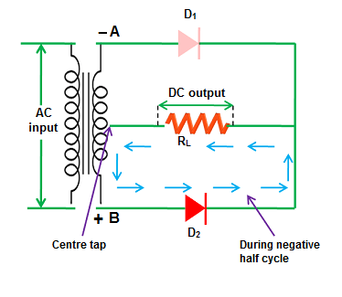
During the negative half cycle of the input AC signal, terminal A become negative, terminal B become positive and center tap is grounded (zero volts).
The negative terminal A is connected to the p-side of the diode D₁ and the positive terminal B is connected to the n-side of the diode D₁.
So the diode D₁ is reverse biased during the negative half cycle and does not allow electric current through it.

Slide 17
On the other hand, the positive terminal B is connected to the p-side of the diode D₂ . So the diode D₂ is forward biased during the negative half cycle and allows electric current through it.
The diode D₂ supplies DC current to the load R_{L}.
The DC current produced at the load R_{L} will return to the secondary winding through a center tap.
Thus, during the negative half cycle of the input AC signal, only diode D₂ allows electric current while diode D₁ does not allow electric current.

Slide 18
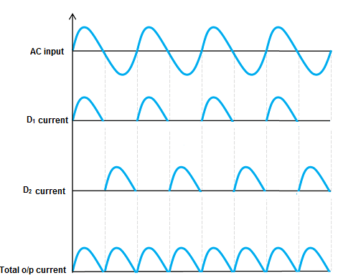
Thus, the diode D₁ allows electric current during the positive half cycle and diode D₂ allows electric current during the negative half cycle of the input AC signal.
As a result, both half cycles (positive and negative) of the input AC signal are allowed.
So the output DC voltage is almost equal to the input AC .

Slide 19

Ripple factor of Full Wave Rectifier
The ripple factor is given by :$γ=\sqrt{{\left(\frac{I_{rms}^{}}{I_{dc}}\right)}^{2}−1}$
DC output current
At the output load resistor R_{L}, both the diode D₁ and diode D₂ currents flow in the same direction. So the output current is the sum of D₁ and D₂ currents.
The current produced by D₁ is I_{max} / π and the current produced by D₂ is I_{max} / π.
So the output current I_{DC} = 2I_{max} / π
Where I_{max} = maximum DC load current
The root mean square (RMS) value of a full wave rectifier is I_{rms} = I_{m}/√ 2
Thus the ripple factor of full wave rectifier is γ = 0.48

Slide 20
Rectifier efficiency of Full Wave Rectifier
Rectifier efficiency can be mathematically written as
η = output P_{DC} / input P_{AC}
The rectifier efficiency of a full wave rectifier is 81.2%.
The rectifier efficiency of a full wave rectifier is twice that of the half wave rectifier.
So the full wave rectifier is more efficient than a half wave rectifier.
Peak inverse voltage (PIV)
Peak inverse voltage or peak reverse voltage is the maximum voltage a diode can withstand in the reverse bias condition. If the applied voltage is greater than the peak inverse voltage, the diode will be permanently destroyed.
The peak inverse voltage (PIV) = 2V_{m}

Slide 21
Advantages of full wave rectifier with center tapped transformer
High rectifier efficiency.
Low power loss.
Low ripples
Disadvantages of full wave rectifier with center tapped transformer
High cost
The center tapped transformers are expensive and occupy a large space.

Slide 22
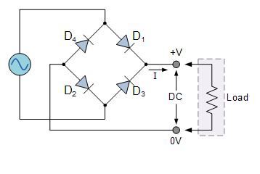
Bridge Rectifier
A Bridge rectifier is an Alternating Current (AC) to Direct Current (DC) converter that rectifies mains AC input to DC output.
Bridge Rectifiers are widely used in power supplies that provide necessary DC voltage for the electronic components or devices.
They can be constructed with four or more diodes or any other controlled solid state switches.
Circuit diagram
The four diodes labelled D₁ to D₄ are arranged in “series pairs” with only two diodes conducting current during each half cycle.

Slide 23
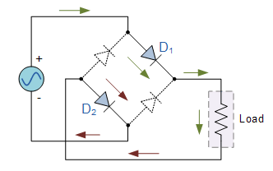
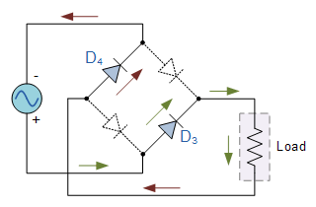
During the positive half cycle of the supply, diodes D1 and D2 conduct in series while diodes D3 and D4 are reverse biased and the current flows through the load as shown below.
Positive half cycle Negative half cycle
During the negative half cycle of the supply, diodes D3 and D4 conduct in series, but diodes D1 and D2 switch “OFF” as they are now reverse biased. The current flowing through the load is the same direction as before.

Slide 24
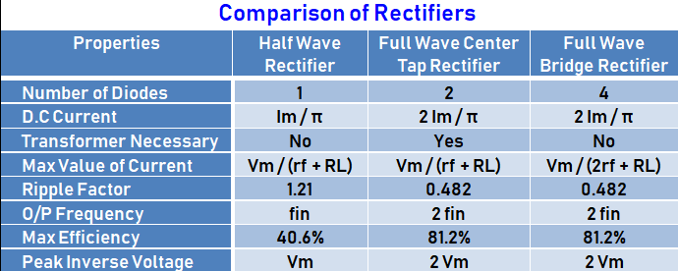

Slide 25
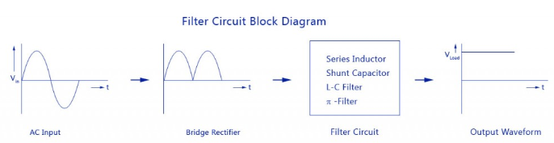
Filters
The filter is a device that allows passing the dc component of the load and blocks the ac component of the rectifier output.
Thus the output of the filter circuit will be a steady dc voltage.
The filter circuit can be constructed by the combination of components like capacitors, resistors, and inductors.
Inductor is used for its property that it allows only dc components to pass and blocks ac signals.
Capacitor is used so as to block the dc and allows ac to pass.
Block Diagram

Slide 26
Full wave rectifier with Inductor filter
As the name of the filter circuit suggests, the Inductor L is connected in series between the rectifier circuit and the load.
The inductor carries the property of opposing the change in current that flows through it.
In other words, the inductor offers high impedance to the ripples and no impedance to the desired dc components. Thus the ripple components will be eliminated.
When the rectifier output current increases above a certain value, energy is stored in it in the form of a magnetic field and this energy is given up when the output current falls below the average value.
Thus all the sudden changes in current that occurs in the circuit will be smoothened by placing the inductor in series between the rectifier and the load.

Slide 27
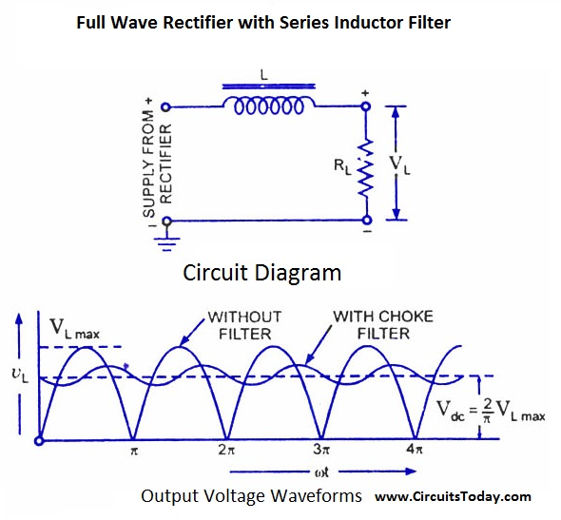
The waveform below shows the use of inductor in the circuit.
From the circuit, for zero frequency dc voltage, the choke resistance Ri in series with the load resistance RL forms a voltage divider circuit, and thus the dc voltage across the load is Vdc = RL/(Ri + RL)

Slide 28
The effect of higher harmonic voltages can be easily neglected as better filtering for the higher harmonic components take place.
This is because of the fact that with the increase in frequency, the reactance of the inductor also increases. It should be noted that a decrease in the value of load resistance or an increase in the value of load current will decrease the amount of ripples in the circuit.
So, the series inductor filter is mostly used in cases of high load current or small load resistance.

Slide 29
SHUNT CAPACITOR FILTER
As the name suggests, a capacitor is used as the filter and this high value capacitor is shunted or placed across the load impedance.
This capacitor, when placed across a rectifier gets charged and stores the charged energy during the conduction period. When the rectifier is not conducting, this energy charged by the capacitor is delivered back to the load.
Through this energy storage and delivery process, the time duration during which the current flows through the load resistor gets increased and the ripples are decreased by a great amount.
Thus for the ripple component with a frequency of ‘f’ megahertz, the capacitor ‘C’ will offer a very low impedance. The value of this impedance can be written as: Shunt Capacitor Impedance = 1/2 fC

Slide 30
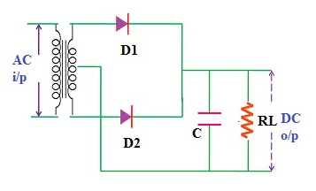
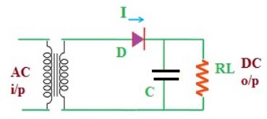
Thus the dc components of the input signal along with the few residual ripple components, is only allowed to go through the load resistance RLoad. The high amount of ripple components of current gets bypassed through the capacitor C.
Half wave rectifier with capacitor filter
Full wave rectifier with capacitor filter

Slide 31
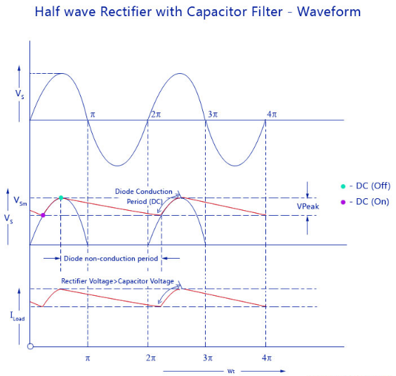
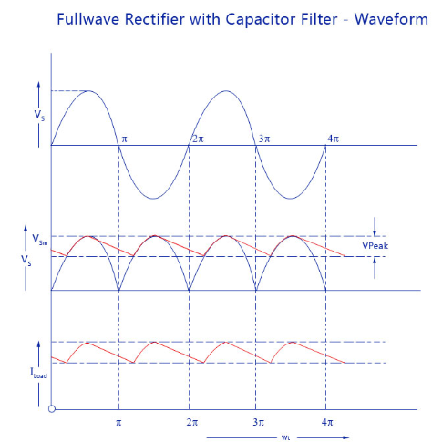

Slide 32
RC COUPLED AMPLIFIER
A Resistance Capacitance (RC) Coupled Amplifier is basically a multi-stage amplifier circuit extensively used in electronic circuits.
Here the individual stages of the amplifier are connected together using a resistor–capacitor combination due to which it bears its name as RC Coupled. It is a two-stage amplifier whose individual stages are nothing but the common emitter amplifiers.
Hence the design of individual stages of the RC coupled amplifiers is similar to that in the case of common emitter amplifiers

Slide 33
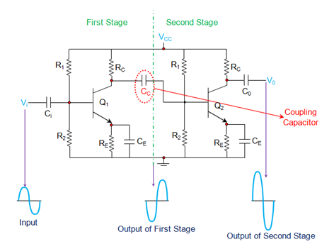
Circuit Diagram of RC Coupled Amplifier
Resistors R₁ and R₂ form the biasing network
The emitter resistor RE form the stabilization network.

Slide 34
RC COUPLED AMPLIFIER
Here the C_{E} is also called bypass capacitor which passes only AC while restricting DC, which causes only DC voltage to drop across R_{E} while the entire AC voltage will be coupled to the next stage.
Further, the coupling capacitor C_{C} also increases the stability of the network as it blocks the DC while offers a low resistance path to the AC signals, thereby preventing the DC bias conditions of one stage affecting the other.
In addition, in this circuit, the voltage drop across the collector-emitter terminal is chosen to be 50% of the supply voltage V_{CC} in order to ensure appropriate biasing point.

Slide 35
OPERATION:
The AC component of this signal is coupled to the second stage of the RC coupled amplifier through the coupling capacitor C_{C} and thus appears as an input at the base of the second transistor Q₂.
This is further amplified and is passed-on as an output of the second stage and is available at the collector terminal of Q₂ after being shift by 180º in its phase.
This means that the output of the second stage will be 360º out-of-phase with respect to the input, which in turn indicates that the phase of the input signal and the phase of the output signal obtained at stage II will be identical.
Further it is to be noted that the cascading of individual amplifier stages increases the gain of the overall circuit as the net gain will be the product of the gain offered by the individual stages.

Slide 36
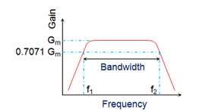
The frequency response of a RC coupled amplifier (a curve of amplifier’s gain v/s frequency), indicates that the gain of the amplifier is constant over a wide range of mid-frequencies while it decreases considerably both at low and high frequencies.
This is because, at low frequencies, the reactance of coupling capacitor C_{C} is high which causes a small part of the signal to couple from one stage to the other.
Moreover for the same case, even the reactance of the emitter capacitor C_{E} will be high due to which it fails to shunt the emitter resistor R_{E} effectively which in turn reduces the voltage gain.

Slide 37
On the other hand, at high frequencies, the reactance of C_{C} will be low which causes it to behave like a short circuit. This results in an increase in the loading effect of the next stage and thus reduces the voltage gain. In addition to this, for this case, the capacitive reactance of the base-emitter junction will be low. This results in a reduced voltage gain as it causes the base current to increase which in turn decreases the current amplification factor β. However, in mid-frequency range, as the frequency increases, the reactance of C_{C} goes on decreasing which would lead to the increase in gain if not compensated by the fact that the reduction in reactance leads to an increase in the loading effect. Due to this reason, the gain of the amplifier remains uniform/constant throughout the mid-frequency band.

Slide 38
Advantages of RC Coupled Amplifier Cheap Economical and compact as it uses only resistors and capacitors. Offers a constant gain over a wide frequency band. Disadvantages of RC Coupled Amplifier Unsuitable for low-frequency amplification. Low voltage and power gain. Moisture-sensitive, making them noisy as time elapses. Poor impedance matching Narrow bandwidth when compared to JFET amplifier Applications of RC Coupled Amplifier RF Communications. Optical Fiber Communications. Public address systems as pre-amplifiers Controllers Radio or TV Receivers as small signal amplifiers.

Slide 39
POSITIVE AND NEGATIVE FEEDBACK
Feedback
The process of injecting a fraction of output energy of some device back to the input is known as feedback.
It has been found very useful in reducing noise in amplifiers and making amplifier operation stable.
Depending upon whether the feedback energy aids or opposes the input signal, there are two basic types of feedback in amplifiers
Positive Feedback.
Negative Feedback.

Slide 40
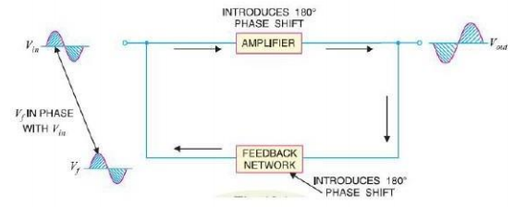
POSITIVE FEEDBACK
When the feedback energy (voltage or current) is in phase with the input signal and thus aids it, it is called positive feedback.
Both amplifier and feedback network introduce a phase shift of 180°.
The result is a 360° phase shift around the loop, causing the feedback voltage Vf to be in phase with the input signal Vin.
Block Diagram of Positive feedback

Slide 41
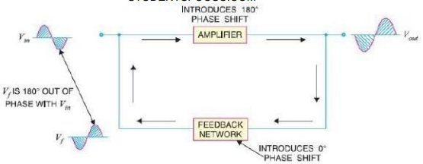
NEGATIVE FEEDBACK
When the feedback energy (voltage or current) is out of phase with the input signal and thus opposes it, it is called negative feedback. Negative feedback reduces the gain of the amplifier.
However, the advantages of negative feedback are: reduction in distortion, stability in gain, increased bandwidth and improved input and output impedances.
It is due to these advantages that negative feedback is frequently employed in amplifiers.
Block Diagram of Negative feedback

Slide 42
COMPARISON BETWEEN POSITIVE AND NEGATIVE FEEDBACK
POSITIVE FEEDBACK | NEGATIVE FEEDBACK
When the feedback energy (voltage or current) is in phase with the input signal and thus aids , it is called positive feedback. | When the feedback energy (voltage or current) is out of phase with the input signal and thus opposes it, it is called negative feedback.
The positive feedback increases the gain of the amplifier | The negative feedback decreases the gain of the amplifier
It has the disadvantages of increased distortion and instability. | The distortion is less and the stability is more.
Positive feedback is employed in Oscillators | Negative feedback is employed in amplifiers.

Slide 43
OSCILLATOR An oscillator is a circuit which produces a continuous, repeated, alternating waveform without any input. Oscillators basically convert unidirectional current flow from a DC source into an alternating waveform which is of the desired frequency, as decided by its circuit components. Basic Principle: The basic principle behind the working of oscillators can be understood by analyzing the behavior of an LC tank circuit. It employs an inductor L and a completely pre-charged capacitor C as its components. Here, at first, the capacitor starts to discharge via the inductor, which results in the conversion of its electrical energy into the electromagnetic field, which can be stored in the inductor.

Slide 44
Basic Principle: Once the capacitor discharges completely, there will be no current flow in the circuit. The stored electromagnetic field would have generated a back-emf which results in the flow of current through the circuit in the same direction as that of before. This current flow through the circuit continues until the electromagnetic field collapses which result in the back-conversion of electromagnetic energy into electrical form, causing the cycle to repeat. However, now the capacitor would have charged with the opposite polarity, due to which one gets an oscillating waveform as the output.

Slide 45
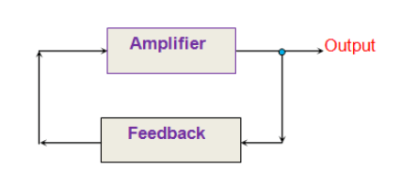
General Block Diagram of oscillator Practically, the oscillators are nothing but the amplifier circuits which are provided with a positive or regenerative feedback wherein a part of the output signal is fed back to the input. Here the amplifier consists of an amplifying active element which can be a transistor or an Op-Amp and the back-fed in-phase signal is held responsible to keep-up (sustain) the oscillations by making-up for the losses in the circuit. The requirements for oscillation are described by the Baukhausen criterion: The magnitude of the loop gain Aβ must be 1 The phase shift of the loop gain A β must be 0º or 360º or integral multiple of 2∏.

Slide 46
TYPES OF OSCILLATORS Classification Based on the Feedback Mechanism: Positive Feedback Oscillators Negative Feedback Oscillators Classification Based on the Shape of the Output Waveform: Sine Wave Oscillators Square or Rectangular Wave oscillators Sweep Oscillators Classification Based on the Nature of the Frequency : Fixed Frequency Oscillators Variable or Tunable Frequency Oscillators Classification Based on the type of the Frequency Control Used: RC Oscillators LC Oscillators Crystal Oscillators

Slide 47
TYPES OF OSCILLATORS Classification Based on the Frequency of the Output Signal: Low-Frequency Oscillators Audio Oscillators Radio Frequency Oscillators High-Frequency Oscillators Very High-Frequency Oscillators Ultra High-Frequency Oscillators

Slide 48
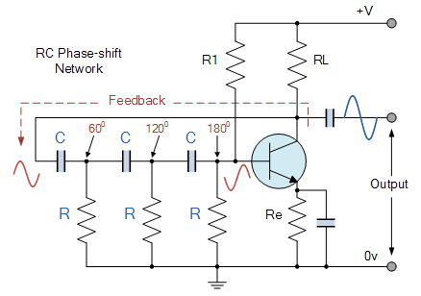
RC Phase Shift Oscillator
RC OSCILLATORS
Circuit Diagram

Slide 49
Operation
The basic RC Oscillator which is also known as a Phase-shift Oscillator, produces a sine wave output signal using regenerative feedback obtained from the resistor-capacitor (RC) ladder network.
This regenerative feedback from the RC network is due to the ability of the capacitor to store an electric charge, (similar to the LC tank circuit).
This resistor-capacitor feedback network can be connected as shown above to produce a phase shift such that the overall phase-shift is 360º.
By varying one or more of the resistors or capacitors in the phase-shift network, the frequency can be varied.

Slide 50

If the three resistors, R are equal in value, that is R₁ = R₂ = R₃, and the capacitors, C in the phase shift network are also equal in value, C₁ = C₂ = C₃, then the frequency of oscillations produced by the RC oscillator is simply given as:
where: ƒ_{r} is the oscillators output frequency
R is the feedback resistance C is the feedback capacitance
N is the number of RC feedback
Advantages of RC Phase Shift Oscillator
The oscillator circuit designing is easy
This circuit is not expensive and gives excellent frequency stability.
These are mainly suitable for low-frequencies
This circuit is simpler compared with a Wein bridge oscillator. The circuit output is sinusoidal that is somewhat distortion free.
The frequency range of this circuit will range from a few Hz to hundreds of kHz.

Slide 51
Disadvantages of RC-Phase Shift Oscillator
The output of this circuit is small because of the smaller feedback
It requires 12 volts battery for developing a suitably huge feedback voltage.
It is hard for this circuit to create oscillations because of the small feedback
The frequency stability of this circuit is not good to compare with Wien bridge oscillator.
RC Phase Shift Oscillator Applications
This phase shift oscillator is used to generate the signals over an extensive range of frequency.
They used in GPS units.
The applications of this phase shift oscillator include voice synthesis and musical instruments.

Slide 52
Wein Bridge Oscillator
Wien Bridge Oscillator is based on a frequency-selective form of the Wheatstone bridge circuit.
The Wien Bridge oscillator is a two-stage RC coupled amplifier circuit that has
good stability at its resonant frequency,
low distortion
is very easy to tune making it a popular circuit as an audio frequency oscillator
The phase shift of the output signal is considerably different from the previous phase shift RC Oscillator.

Slide 53
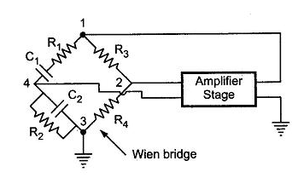

Wein Bridge Oscillator
Circuit Diagram
The Wien Bridge Oscillator uses a feedback circuit consisting of a series RC circuit connected with a parallel RC of the same component values producing a phase delay or phase advance circuit depending upon the frequency.
Wien Bridge Oscillator Frequency
Where:
ƒr is the Resonant Frequency in Hertz
R is the feedback Resistance in Ohms
C is the feedback Capacitance in Farads

Slide 54
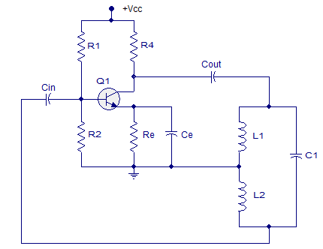
HARTLEY OSCILLATOR
In a Hartley oscillator the oscillation frequency is determined by a tank circuit comprising of two inductors and one capacitor.
The inductors are connected in series and the capacitor is connected across them in parallel.

Slide 55
R1 and R2 give a potential divider bias for the transistor Q1.
Re is the emitter resistor, whose job is to provide thermal stability for the transistor.
Ce is the emitter by pass capacitors, which by-passes the amplified AC signals.
If the emitter by-pass capacitor not there, the amplified ac voltages will drop across Re and it will get added on to the base-emitter voltage of Q1 and will disrupt the biasing conditions.
Cin is the input DC decoupling capacitor while Cout is the output DC decoupling capacitor.
The task of a DC decoupling capacitor is to prevent DC voltages from reaching the succeeding stage.
Inductor L1, L2 and capacitor C1 forms the tank circuit.

Slide 56

Operation:
When the power supply is switched ON the transistor starts conducting and the collector current increases.
As a result the capacitor C1 starts charging and when the capacitor C1 is fully charged it starts discharging through coil L1. This charging and discharging creates a series of damped oscillations in the tank circuit and it is the key.
Since the junction of two inductors is grounded, the voltage across L2 will be 180° out of phase to that of the voltage across L1. The voltage across L2 is actually fed back to the base of Q1.
The feed back voltage is 180° out of phase with the transistor and also the transistor itself will create another 180° phase difference. So the total phase difference between input and output is 360° and it is very important condition for creating sustained oscillations.
Frequency of the Hartley oscillator:

Slide 57
COLPITTS OSCILLATOR
The Colpitts oscillator uses a capacitive voltage divider network as its feedback source.
The two capacitors, C1 and C2 are placed across a single common inductor, L as shown.
Then C1, C2 and L form the tuned tank circuit with the condition for oscillations being: X_{C1} + X_{C2} = X_{L}, the same as for the Hartley oscillator circuit.
The advantage of this type of capacitive circuit configuration is that with less self and mutual inductance within the tank circuit, frequency stability of the oscillator is improved along with a more simple design.
As with the Hartley oscillator, the Colpitts oscillator uses a single stage bipolar transistor amplifier as the gain element which produces a sinusoidal output. C

Slide 58
COLPITTS OSCILLATOR
The emitter terminal of the transistor is effectively connected to the junction of the two capacitors, C1 and C2 which are connected in series and act as a simple voltage divider.
When the power supply is firstly applied, capacitors C1 and C2 charge up and then discharge through the coil L. The oscillations across the capacitors are applied to the base-emitter junction and appear in the amplified at the collector output.
Resistors, R1 and R2 provide the usual stabilizing DC bias for the transistor in the normal manner while the additional capacitors act as a DC-blocking bypass capacitors.
A radio-frequency choke (RFC) is used in the collector circuit to provide a high reactance (ideally open circuit) at the frequency of oscillation, ( ƒr ) and a low resistance at DC to help start the oscillations.

Slide 59
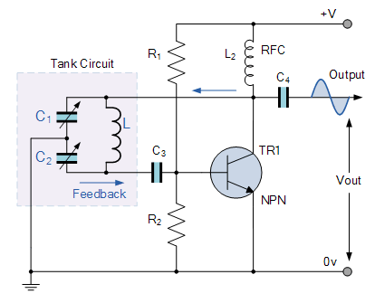
The required external phase shift is obtained in a similar manner to that in the Hartley oscillator circuit with the required positive feedback obtained for sustained undamped oscillations.
The amount of feedback is determined by the ratio of C1 and C2.
These two capacitances are generally “ganged” together to provide a constant amount of feedback so that as one is adjusted the other automatically follows.

Slide 60
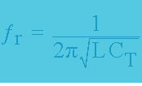
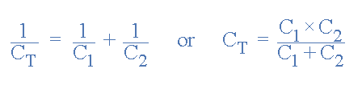
The frequency of oscillations for a Colpitts oscillator is determined by the resonant frequency of the LC tank circuit and is given as:
where C_{T} is the capacitance of C1 and C2 connected in series and is given as:

Slide 61
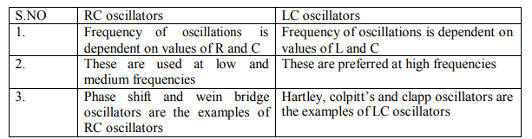
Comparison of RC and LC Oscillators

Slide 62
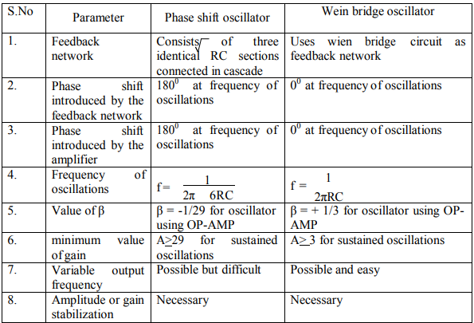
Comparison of RC phase shift & Wein Bridge Oscillators

Slide 63
Oscillator Applications 1.Oscillators are a cheap and easy way to generate specific Frequency of a signal. 2.Quartz watches (which uses a crystal oscillator) 3.Used in various audio systems and video systems 4.Used in various radio, TV, and other communication devices 5.Used in computers, metal detectors, stun guns, inverters, ultrasonic and radio frequency applications. 6.Used to generate clock pulses for microprocessors and micro-controllers 7.Used in alarms and buzzes 8.Used in metal detectors, stun guns, inverters, and ultrasonic 9.Used to operate decorative lights (e.g. dancing lights).

Slide 64
PART A
Define rectifier. Mention the types.
Define ripple factor of a rectifier
Compare Half wave and Full wave rectifier
What is the need for a filter in rectifier?
Draw a two identical stage RC coupled amplifier
List four advantages of RC Coupled amplifier
List four applications of RC Coupled amplifier
What is an oscillator?
State the Barkhausen criterion for an oscillator.
Explain the concept of positive feedback.
Give the over all classification of oscillators?
List four applications of oscillators.
Write down the advantages, disadvantages and applications of Colpitt’s oscillator
Compare RC and LC Oscillators.

Slide 65
PART B
Explain the working of Half Wave Rectifier?
Describe Centre tapped Full wave rectifier and Bridge rectifier in detail?
Explain the working of RC phase shift oscillator?
Explain the working of Wein Bridge shift oscillator?
Explain Colpitt’s oscillator and derive the expression for frequency of oscillation. Also explain the advantages and disadvantages.
Explain Hartley oscillator and obtain the equation for oscillation?

